Slide 1
Machine learning workflow
Machine Learning with Python

Slide 2
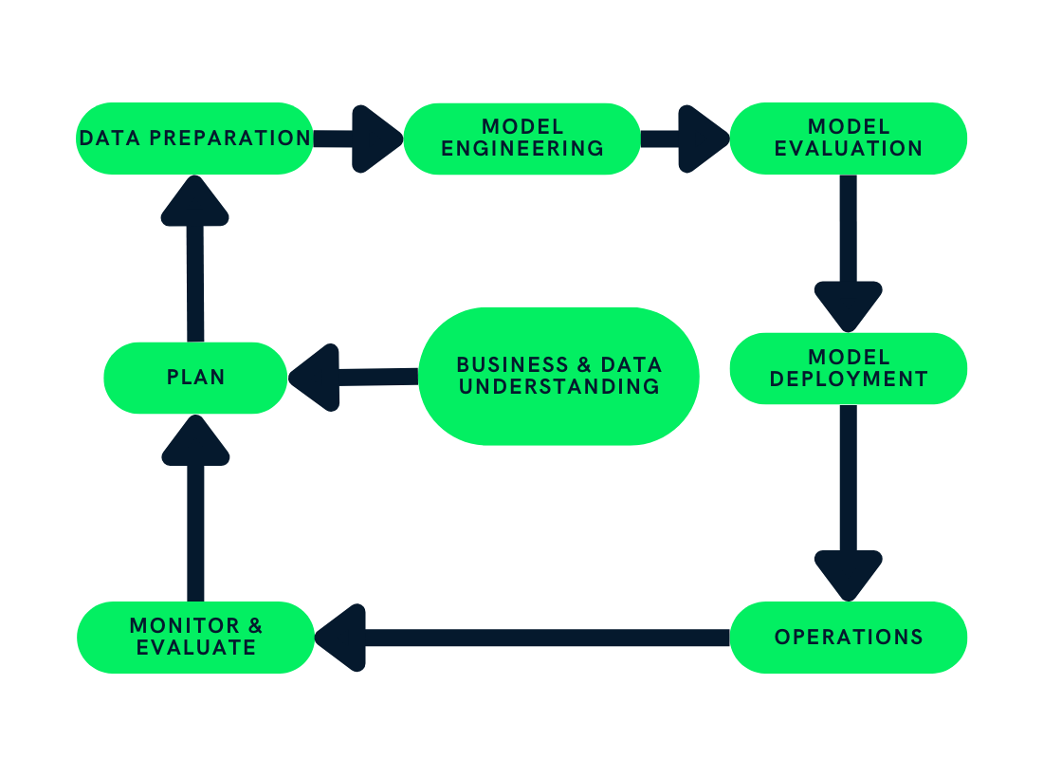
Machine Learning Workflow

Slide 3
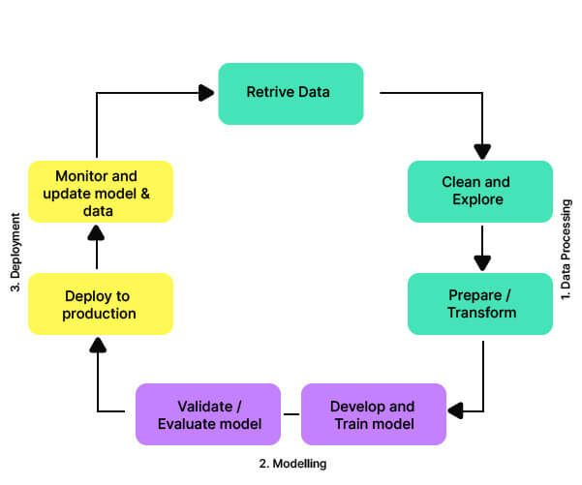
Machine Learning Workflow

Slide 4
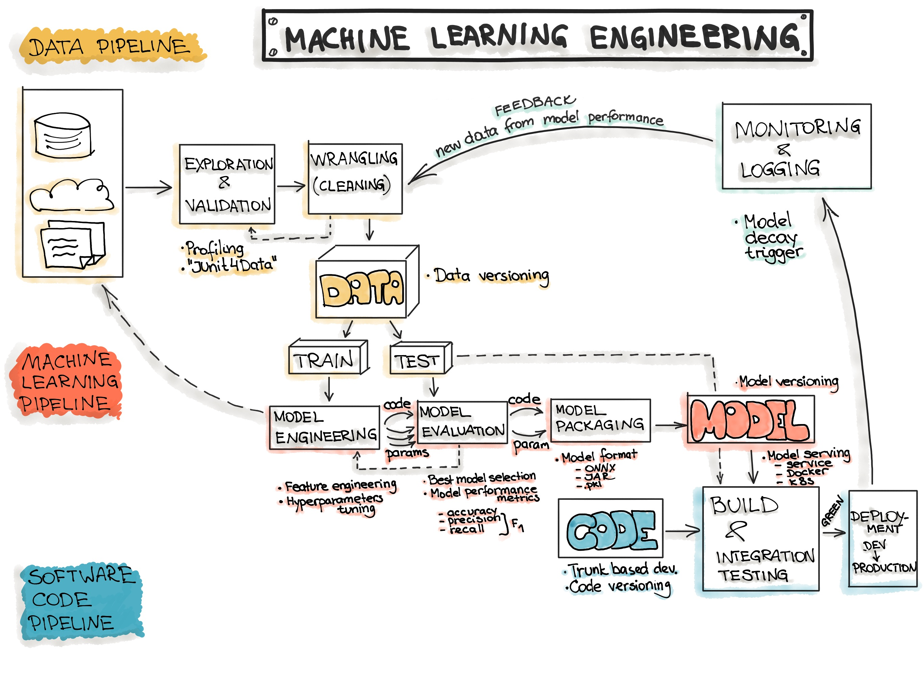

Slide 5
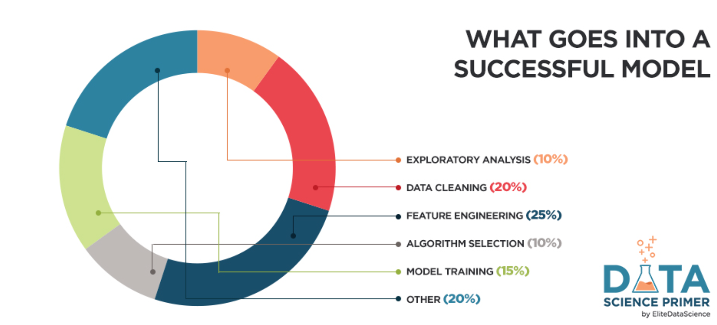

Slide 6
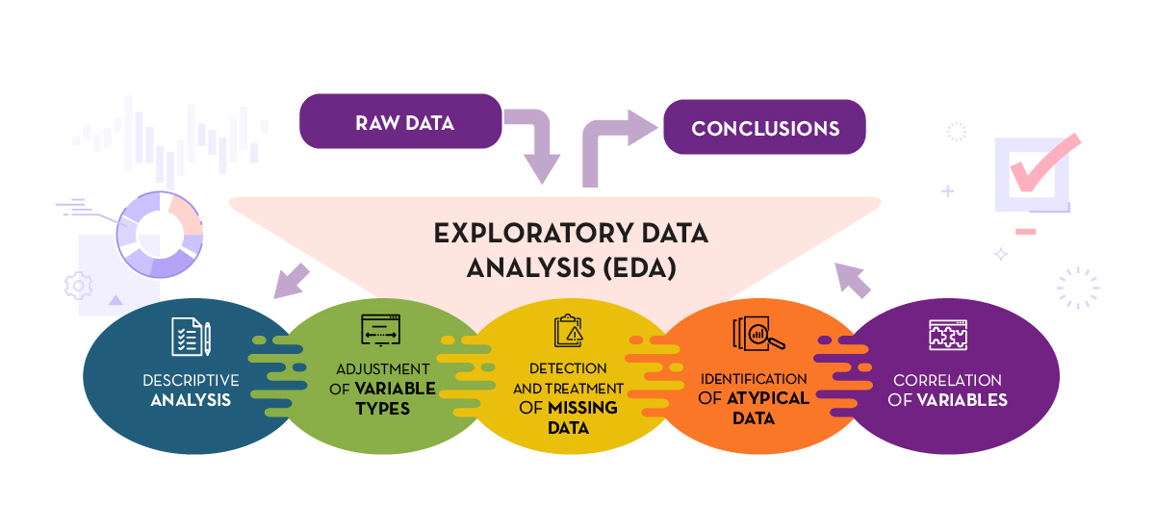

Slide 7
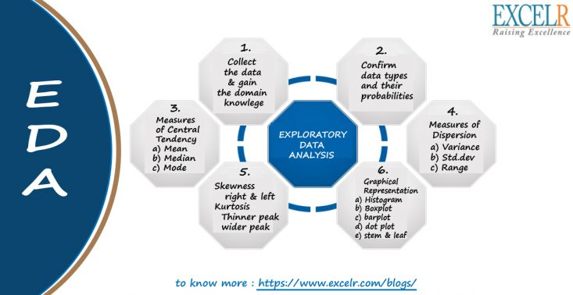

Slide 8
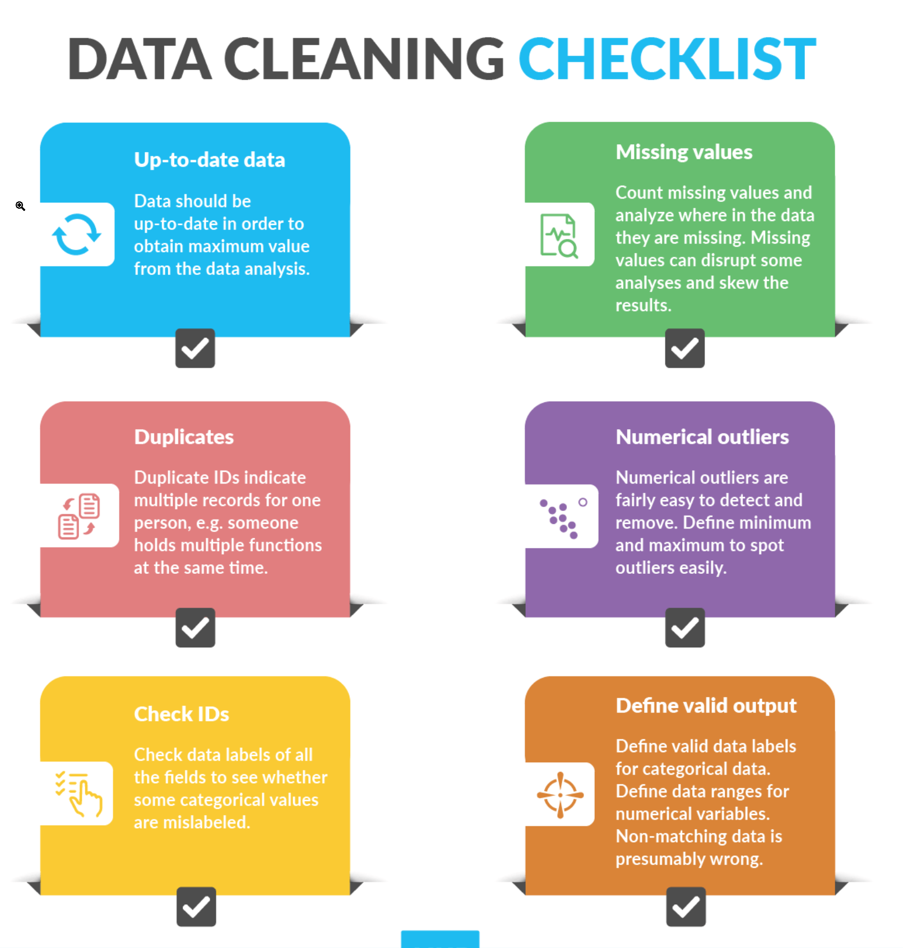

Slide 9
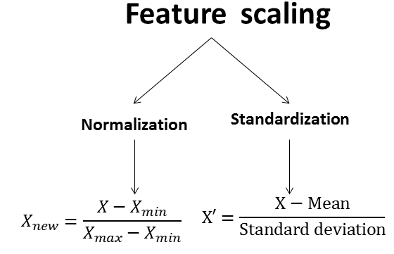

Slide 10
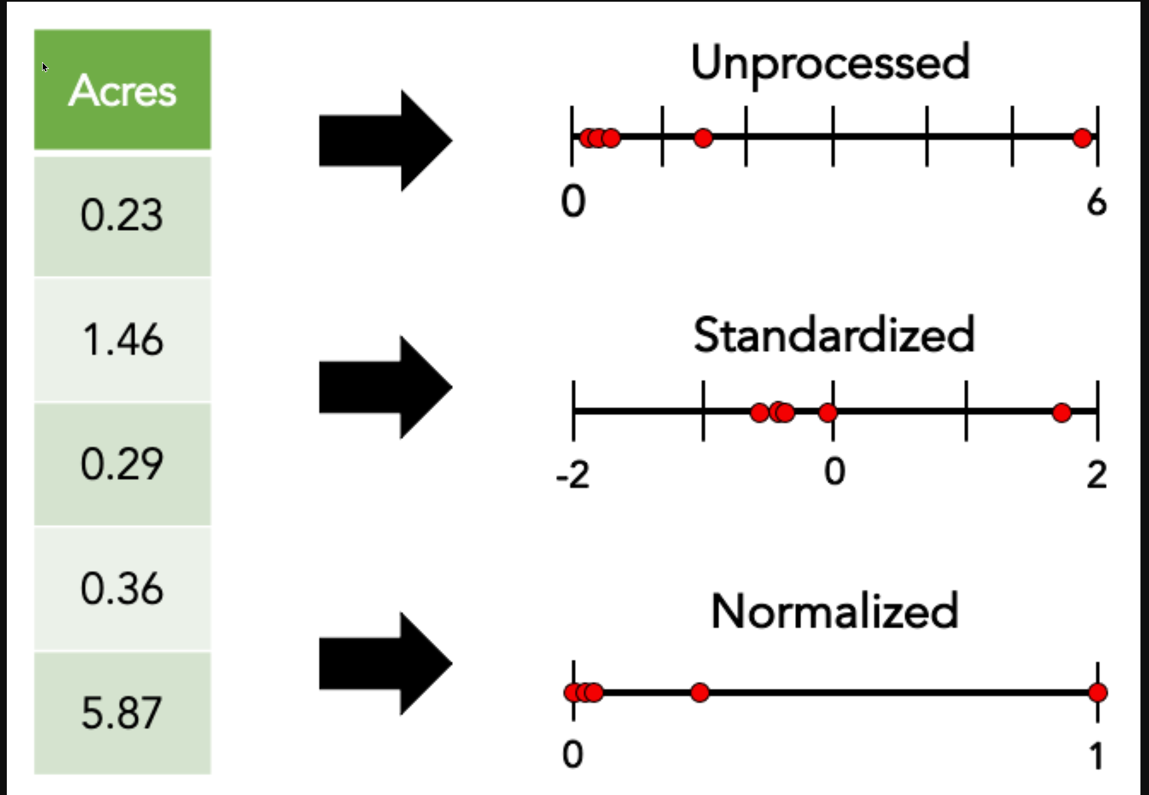

Slide 11
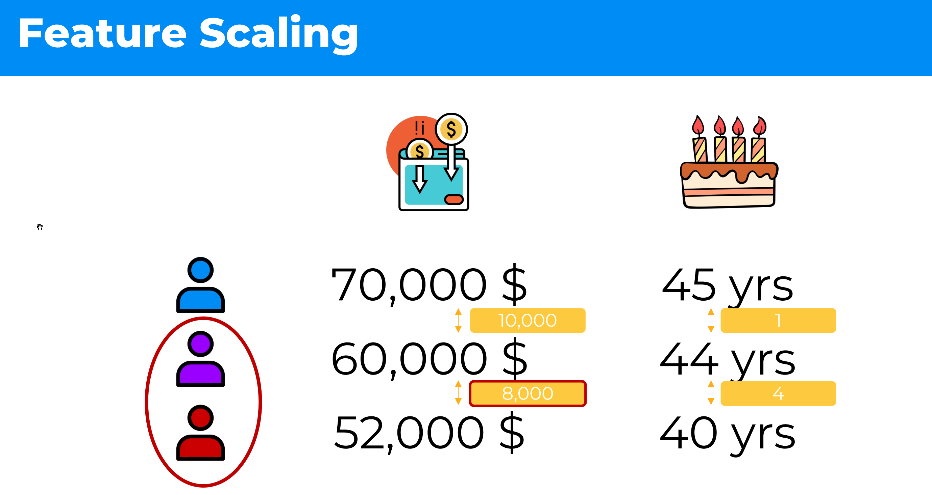

Slide 12
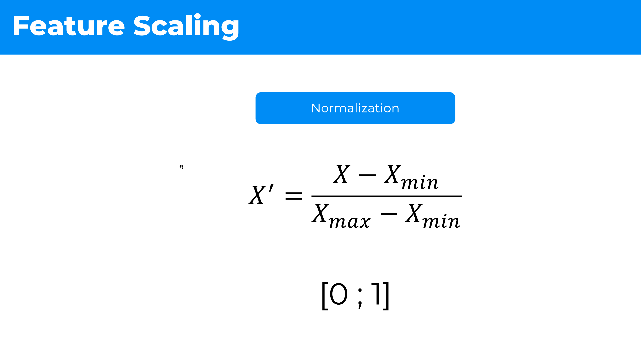

Slide 13
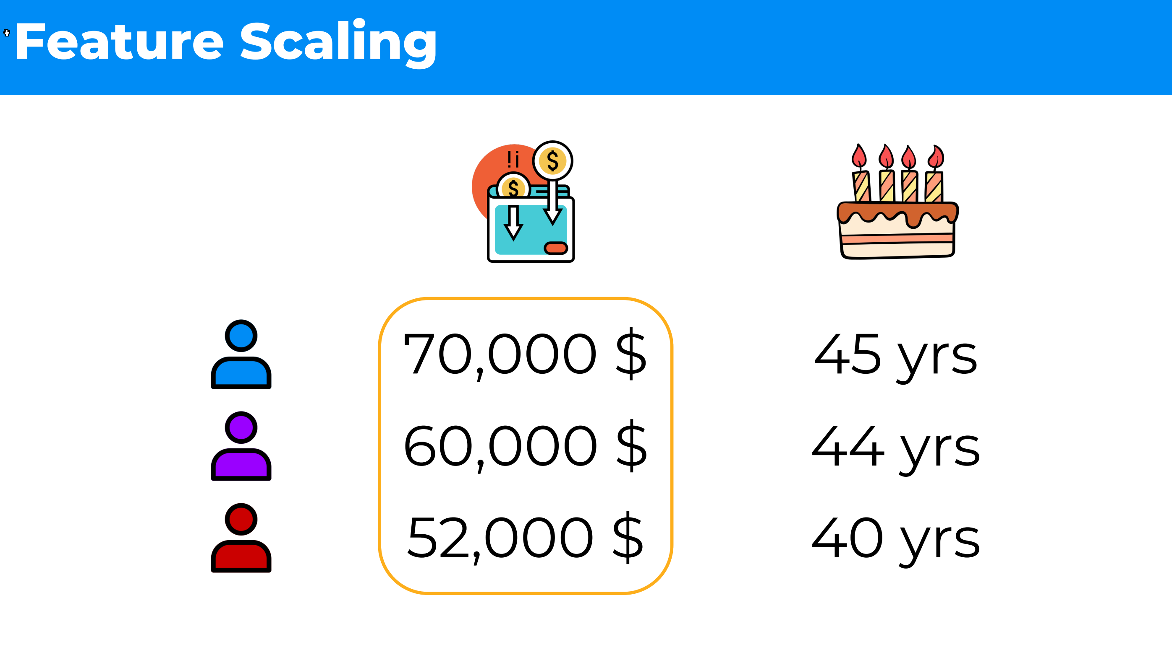

Slide 14
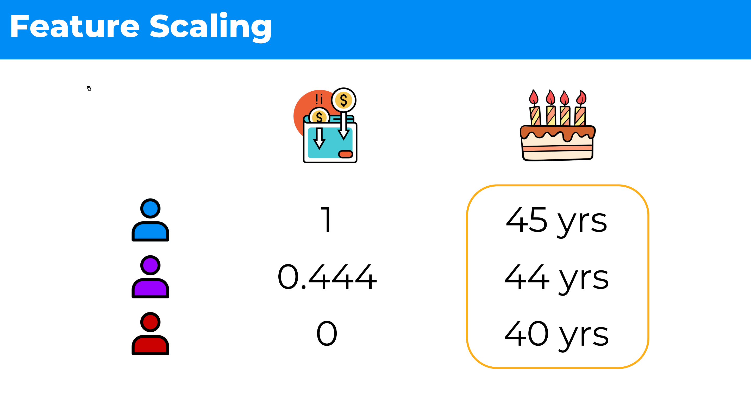

Slide 15
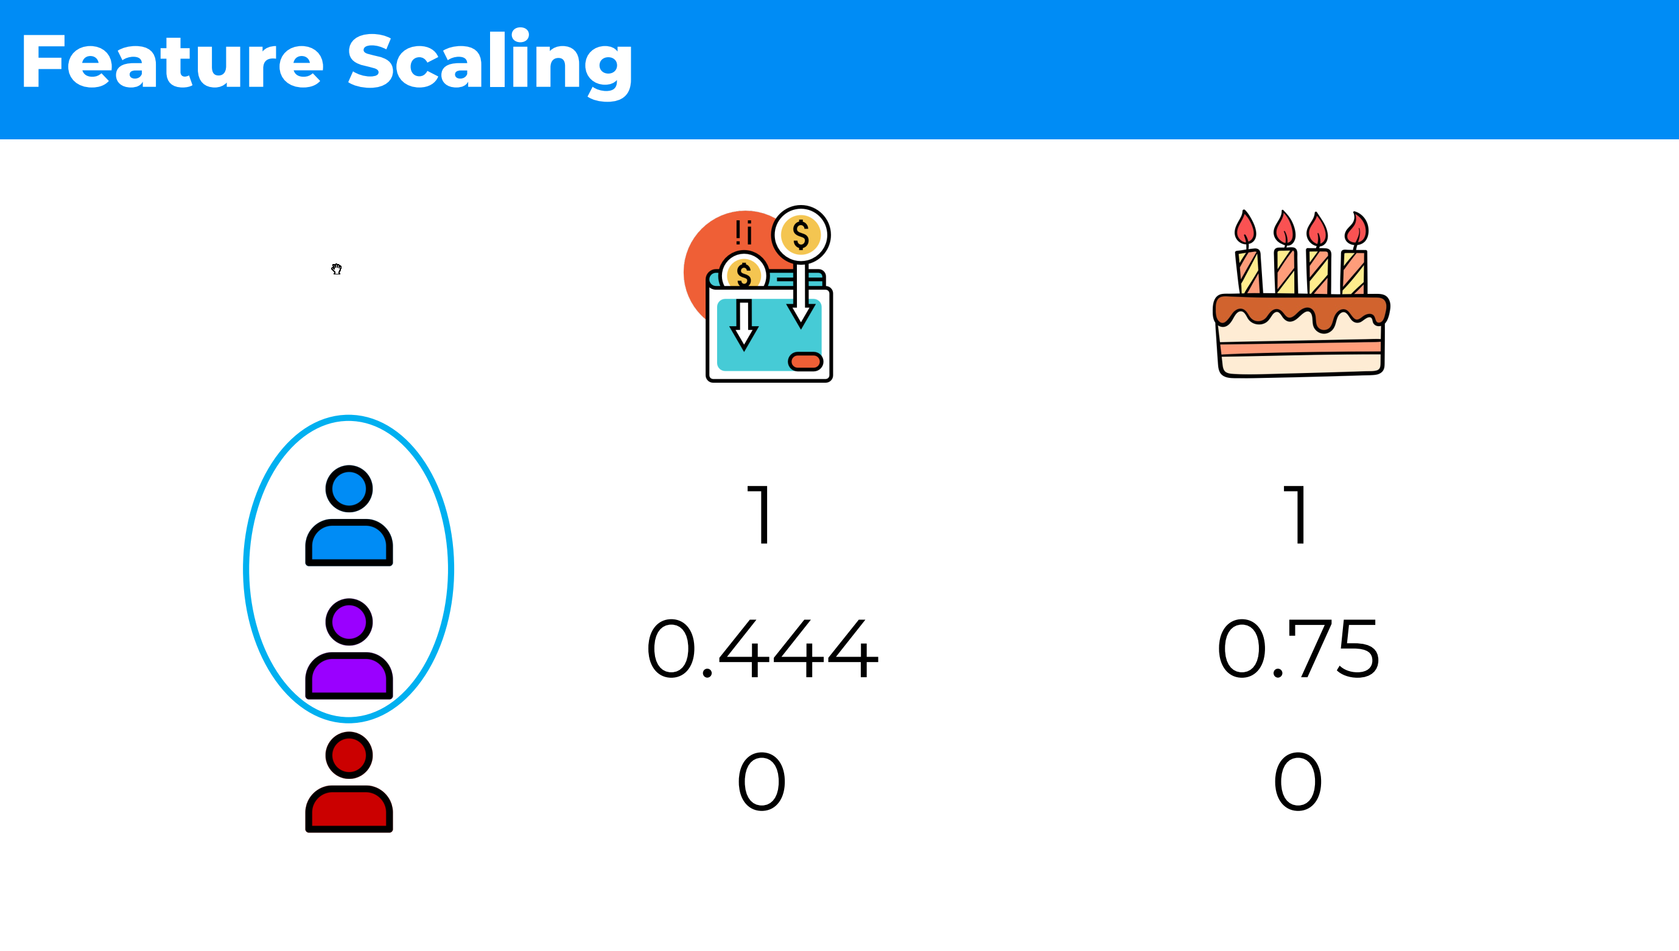

Slide 16
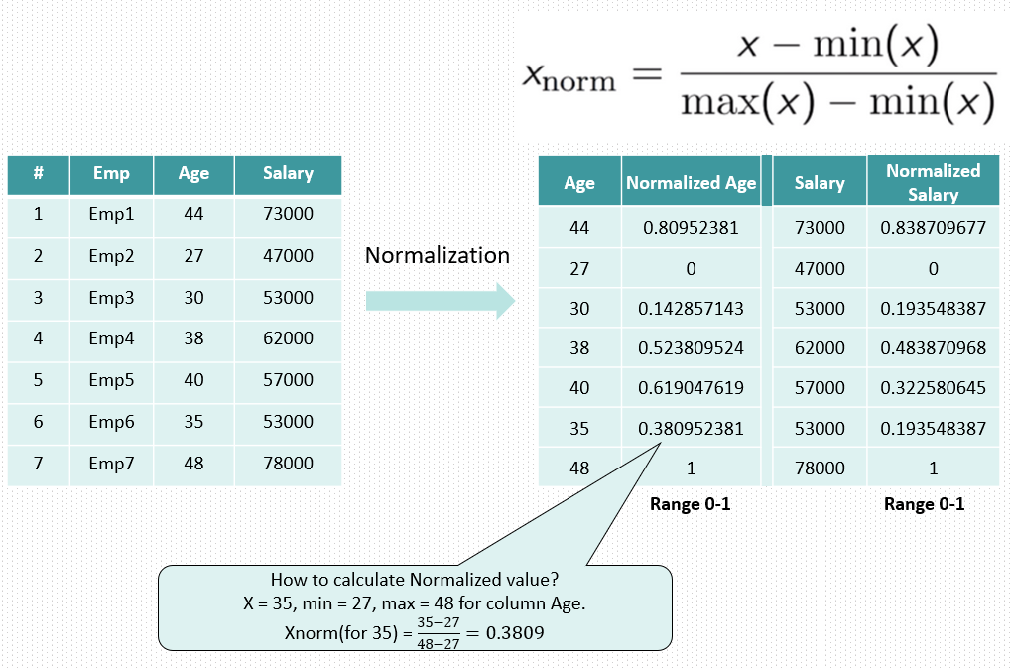

Slide 17
Categorical data
has a finite number of categories or labels for its values, 2 main types
Ordinal categorical variables
values follow a natural order, e.g. primary school, high school, college, university
Nominal categorical variables
values do not follow a natural order, e.g. colors, gender, countries, states

Slide 18
ML models and categorical data
Some models can work with categorical data directly
e.g. decision tree
Most models cannot operate using string inputs
All input and output variables must be numeric
mostly a constraint of efficient implementation of ML algorithms rather than hard limitations, e.g. scikit-learn

Slide 19
Categorical variable encoding
Conversion of categorical data to numeric form
either of feature variable or target variable
If target variable is categorical
may need to convert predictions by the model back into a categorical form in order to present them or use them in some application

Slide 20
Categorical variable encoding types
Ordinal Encoding
One-Hot Encoding
Dummy Variable Encoding

Slide 21
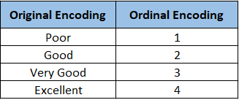

Slide 22
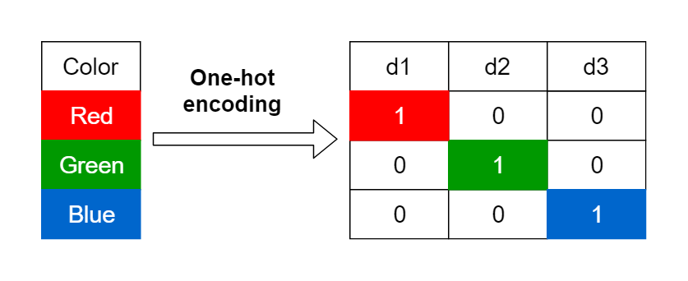
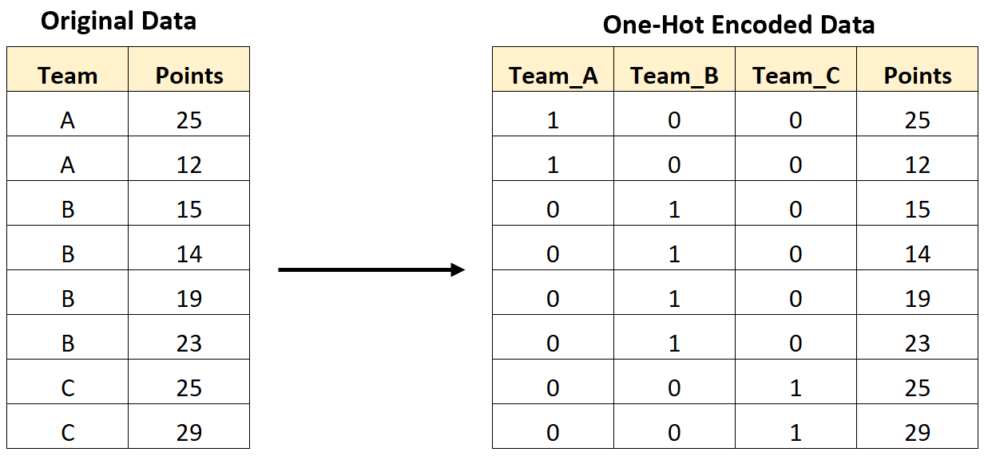

Slide 23
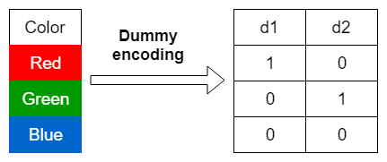
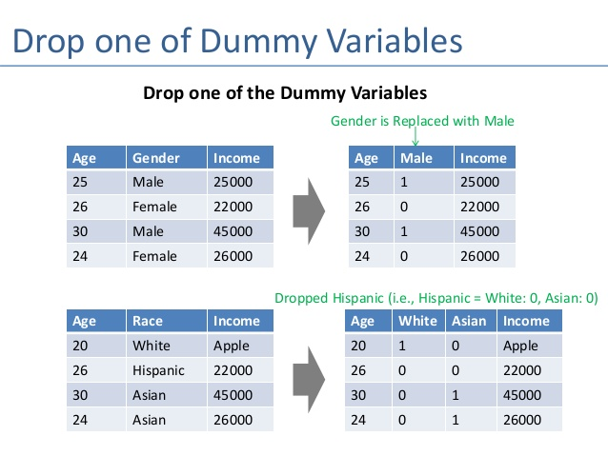
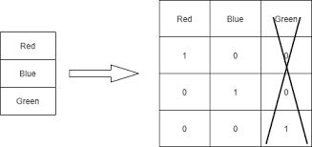

Slide 24
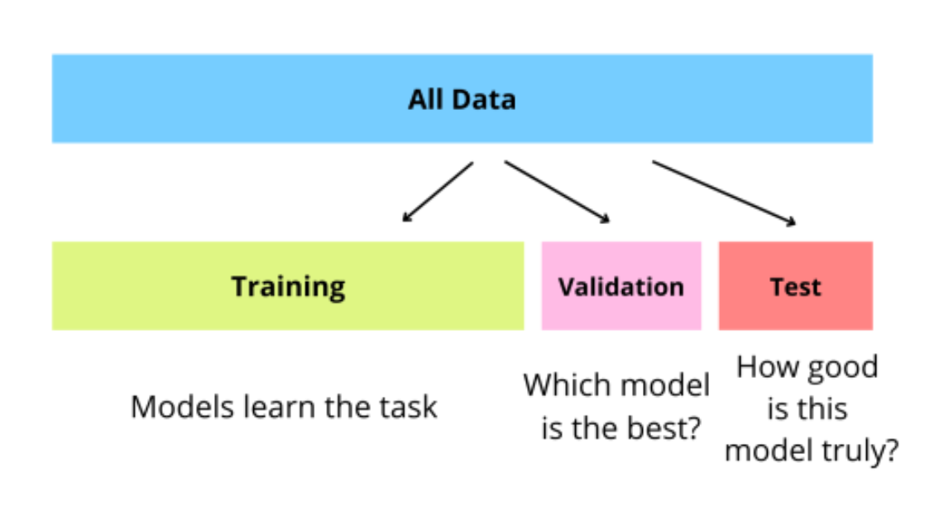
Training, test and validation split

Slide 25
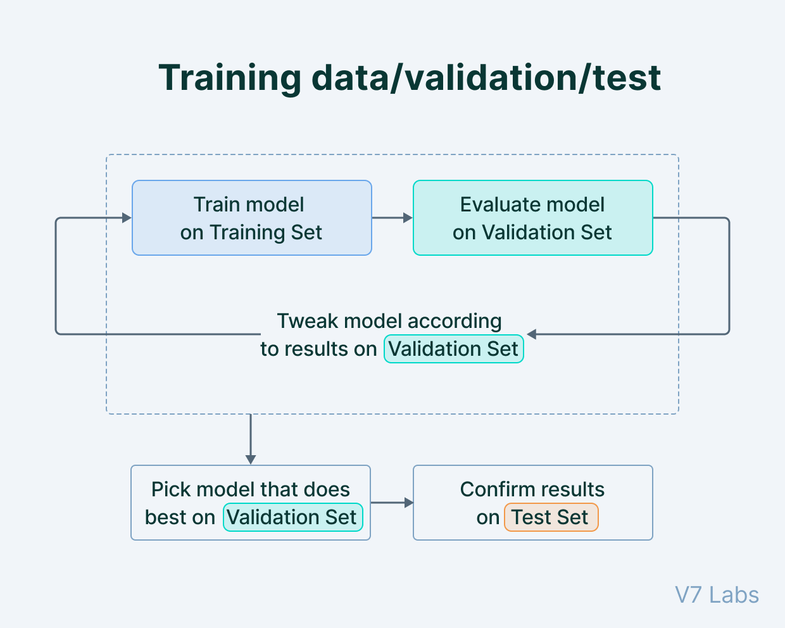

Slide 26
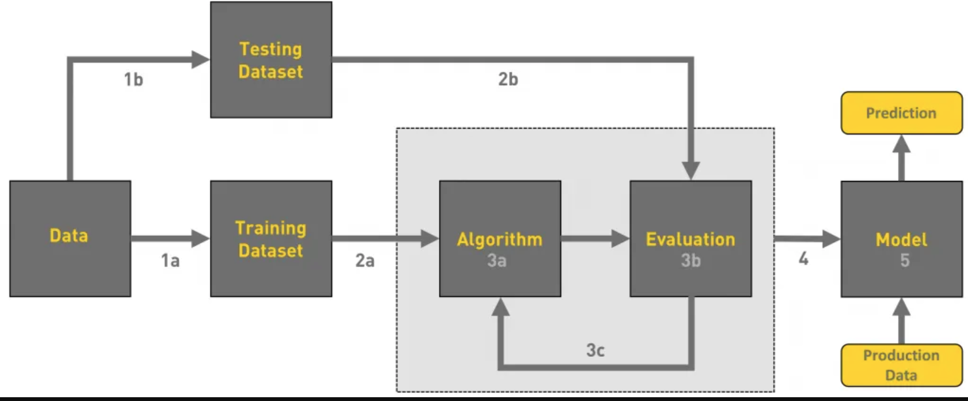
Machine Learning Workflow

Slide 27
Key terms
Model – a set of patterns learned from data.
Algorithm – a specific ML process used to train a model.
Training data – the dataset from which the algorithm learns the model.
Test data – a new dataset for reliably evaluating model performance.
Features – Variables (columns) in the dataset used to train the model.
Target variable – A specific variable you’re trying to predict.
Observations – Data points (rows) in the dataset

Slide 28
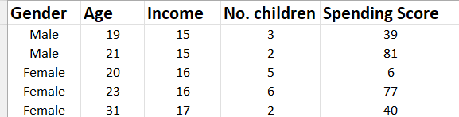
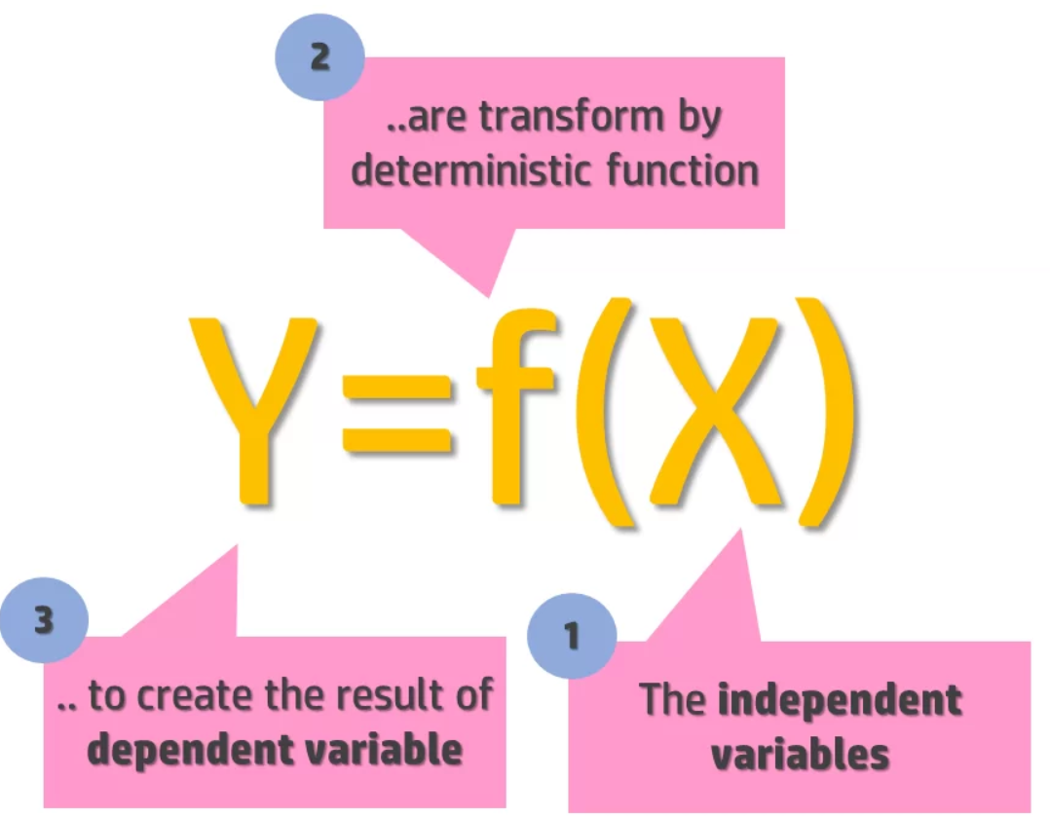
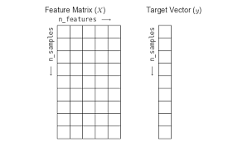
Input / independent / feature variables
Output / dependent / target variable (label)
Observations /
Samples / Datapoints

